Slide 1
Viewing Transformation
Course Title: Computer Graphics
Course Code: CSE – 413
Instructor: Khandaker Jannatul Ritu, Lecturer, Dept. of CSE(BAIUST)

Slide 2
Outlines
Introduction to Viewing Transformation
Viewing transformation
Window port and Viewport in Computer Graphics
Normalization transformation
Window to Viewport Transformation / Viewing transformation / windowing transformation
Workstation transformation
2D Viewing-Transformation Pipeline
Example problems
Difference Between Window Port And Viewport
Computer Graphics Zooming
Computer Graphics Panning
Inking
Scissoring

Slide 3
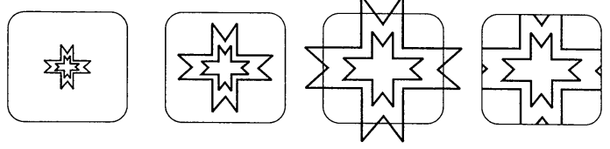
Introduction to Viewing Transformation:
Typically, a graphics package allows us to specify which part of a defined picture is to be displayed and where that part is to be displayed on the display device. Furthermore, the package also provides the use of the scaling, translation and rotation techniques to generate a variety of different views of a single picture.
We can generate different view of a picture by applying the appropriate scaling and translation. While doing this, we have to identify the visible part of the picture for inclusion in the display image.
This selection process is not straight forward. Certain lines may lie partly inside the visible portion of the picture and partly outside. These lines cannot be omitted entirely from the display image because the image would become inaccurate.
The process of selecting and viewing the picture with different views is called windowing, and a process which divides each element of the picture into its visible and invisible portions, allowing the invisible portion to be discarded is called clipping.

Slide 4
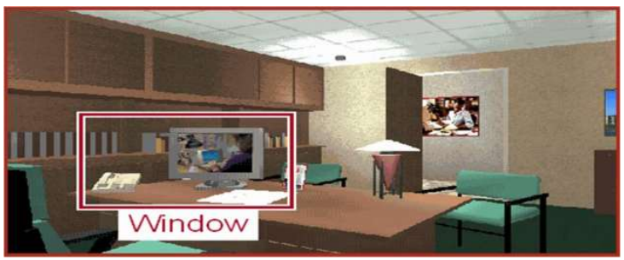
Window port and Viewport in Computer Graphics
Capturing images from the real world and displaying them on the screen is an astonishing process, only if we do not know the underlying process. Here, we will be studying how the images are captured. This process is held by the Window port and Viewport in Computer Graphics.
Window Port
The window port can be confused with the computer window but it isn’t the same. The window port is the area chosen from the real world for display. This window port decides what portion of the real world should be captured and be displayed on the screen.
So, the Window defines what is to be viewed. The widow port can thus be defined as,
"A world-coordinate area selected for display is called a window. A window defines a rectangular area in the world coordinates."
“The Capability to show some part of an object in a window is known as windowing.”
“The rectangular area describes in the world coordinate system is called the window.”

Slide 5
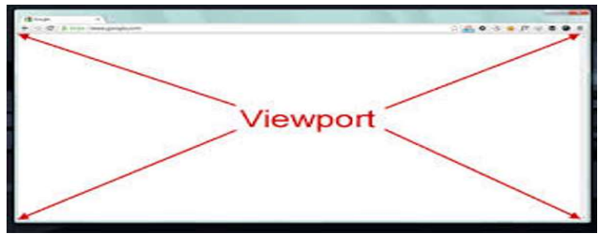
Viewport
Now, the Viewport is the area on a display device to which a window is mapped. “The viewport can be defined as an area on the screen which is used to display the object”. So, Viewport defines where is to be viewed. Thus, the viewport is nothing else but our device’s screen. The viewport can thus be defined as follows:
"A viewport is a polygon viewing region in computer graphics. The viewport is an area expressed in rendering-device-specific coordinates, e.g. pixels for screen coordinates, in which the objects of interest are going to be rendered."
So, to display the image on the computer screen, we must map our window port to the viewport. The capture ratio of the window might not always be similar to or easily adjustable to the viewport. Thus, some necessary transformations adjustments like clipping and cropping are performed on the window.

Slide 6
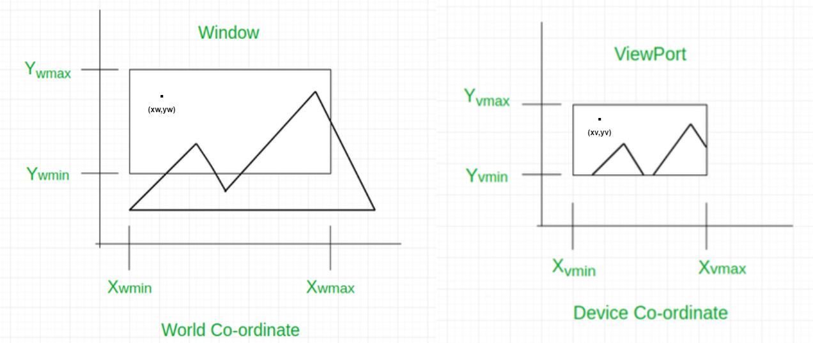
Window to Viewport Transformation /Viewing transformation/windowing transformation
Window to Viewport Transformation is the process of transforming 2D world-coordinate objects to device coordinates. Objects inside the world or clipping window are mapped to the viewport which is the area on the screen where world coordinates are mapped to be displayed.
General Terms:
World coordinate – It is the Cartesian coordinate w.r.t which we define the diagram, like X_{wmin}, X_{wmax}, Y_{wmin}, Y_{wmax}
Device Coordinate –It is the screen coordinate where the objects are to be displayed, like X_{vmin}, X_{vmax}, Y_{vmin}, Y_{vmax}
Window –It is the area on the world coordinate selected for display.
ViewPort –It is the area on the device coordinate where graphics is to be displayed.

Slide 7
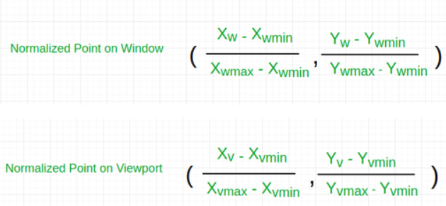
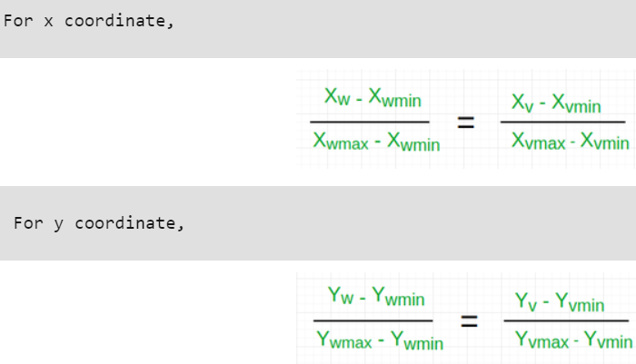
Mathematical Calculation of Window to Viewport:
If (x_{w}, y_{w}) is a point on Window port. Then (x_{v}, y_{v}) is the Corresponding point on Viewport. What is the value of this viewport points (x_{v}, y_{v}) ?
Solution: We have to calculate the point (x_{v}, y_{v})
Now the relative position of the object in Window and Viewport are same.
For x coordinate,
For y coordinate,

Slide 8













calculating for x coordinate:
Considering scaling factor
calculating for y coordinate:
$$⇒$$
$$⇒$$
$$⇒$$
(X_{v} – X_{vmin}) (X_{wmax} - X_{wmin}) = (X_{w}-X_{wmin}) (X_{vmax} - X_{vmin})
X_{v} – X_{vmin} = (X_{w} - X_{wmin}) *
$$⇒$$
(Y_{v} – Y_{vmin}) (Y_{wmax} - Y_{wmin}) = (Y_{w}-Y_{wmin}) (Y_{vmax} - Y_{vmin})
Y_{v} – Y_{vmin} = (Y_{w} - Y_{wmin}) *
Y_{v} = Y_{vmin} + (Y_{w} - Y_{wmin}) * S_{y}
$$⇒$$
$$⇒$$
$$⇒$$
$$⇒$$
Where s_{x} is the scaling factor of x coordinate
Where s_{y} is the scaling factor of y coordinate

Slide 9


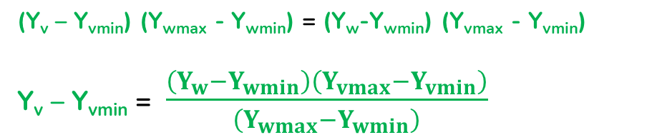

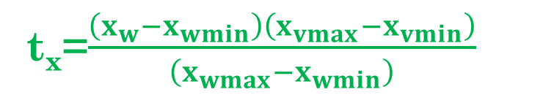



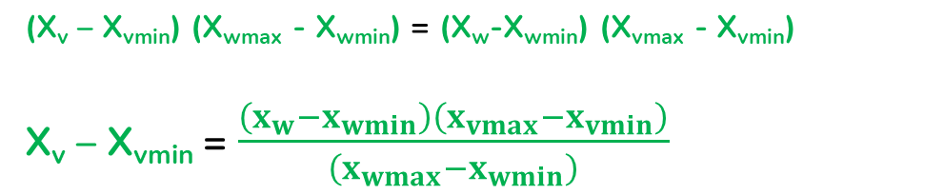


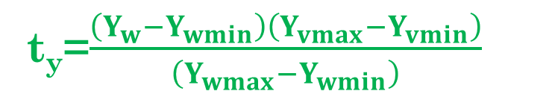
calculating for x coordinate:
Considering translation factor
calculating for y coordinate:
$$⇒$$
$$⇒$$
$$⇒$$
(X_{v} – X_{vmin}) (X_{wmax} - X_{wmin}) = (X_{w}-X_{wmin}) (X_{vmax} - X_{vmin})
X_{v} – X_{vmin} = $\frac{\left(x_{w}−x_{wmin}\right)\left(x_{vmax}−x_{vmin}\right)}{\left(x_{wmax}−x_{wmin}\right)}$
$$⇒$$
(Y_{v} – Y_{vmin}) (Y_{wmax} - Y_{wmin}) = (Y_{w}-Y_{wmin}) (Y_{vmax} - Y_{vmin})
Y_{v} – Y_{vmin} = $\frac{\left(Y_{w}−Y_{wmin}\right)\left(Y_{vmax}−Y_{vmin}\right)}{\left(Y_{wmax}−Y_{wmin}\right)}$
$$⇒$$
$$⇒$$
$$⇒$$
X_{v} = X_{vmin} + t_{x}
Y_{v} = Y_{vmin} + t_{y}
$$⇒$$
Where t_{x} is the translation factor of x coordinate
Where t_{y} is the translation factor of y coordinate
t_{x}=$\frac{\left(x_{w}−x_{wmin}\right)\left(x_{vmax}−x_{vmin}\right)}{\left(x_{wmax}−x_{wmin}\right)}$
t_{y}=$\frac{\left(Y_{w}−Y_{wmin}\right)\left(Y_{vmax}−Y_{vmin}\right)}{\left(Y_{wmax}−Y_{wmin}\right)}$

Slide 10
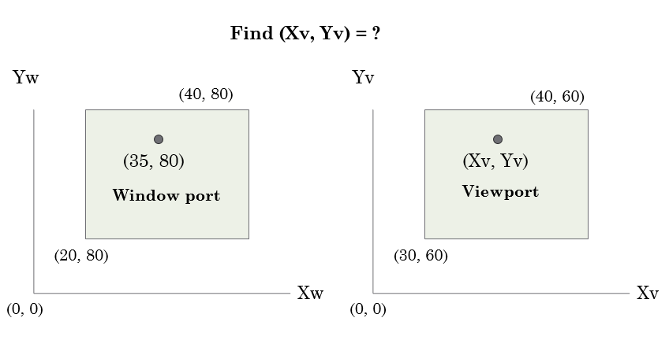
Example-01: If there is a coordinate (x_{w},y_{w}) in the window port what will the corresponding coordinate value(x_{v}, y_{v}) in the viewport with respect to (a) scaling factor and (b) translation factor? Find the equation. [ see previous equation. ]
Example-02: If there is a coordinate point (30, 80) on the window port where the coordinate of lower left corner is (20, 80) and the upper right corner is (40, 80), then will be the corresponding coordinate point(x_{v}, y_{v}) on viewport where the coordinate of lower left corner is (30, 60) and the upper right corner is (40, 60),
Solution:
Let us assume,
for window, X_{wmin} = 20, X_{wmax} = 80, Y_{wmin} = 40, Y_{wmax} = 80.
for viewport, X_{vmin} = 30, X_{vmax} = 60, Y_{vmin} = 40, Y_{vmax} = 60.
Now a point ( X_{w}, Y_{w} ) be ( 30, 80 ) on the window. We have to calculate that point on the viewport i.e ( X_{v}, Y_{v} ).
First of all, calculate the scaling factor of x coordinate S_{x} and the scaling factor of y coordinate S_{y} using the above-mentioned formula.
Sx = ( 60 - 30 ) / ( 80 - 20 ) = 30 / 60
Sy = ( 60 - 40 ) / ( 80 - 40 ) = 20 / 40
So, now calculate the point on the viewport ( Xv, Yv ).
Xv = 30 + ( 30 - 20 ) * ( 30 / 60 ) = 35
Yv = 40 + ( 80 - 40 ) * ( 20 / 40 ) = 60
So, the point on window ( Xw, Yw ) = ( 30, 80 ) will be ( Xv, Yv ) = ( 35, 60 ) on viewport.

Slide 11
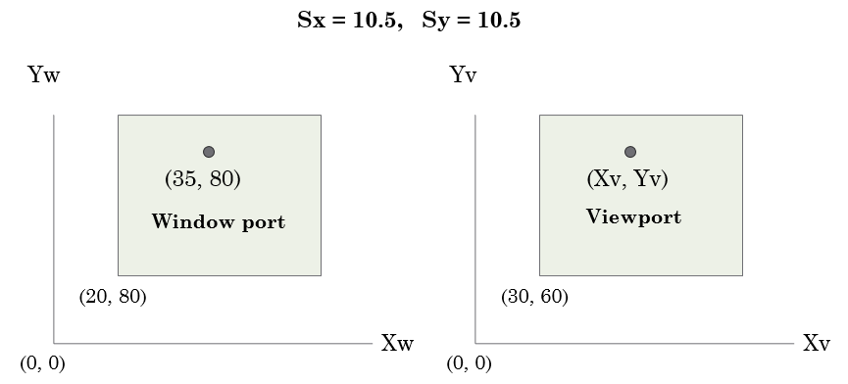
Example-03:
Find (Xv, Yv) = ?
Find (Sx, Sy) = ?
Find (tx, ty) = ?
Example-04:
Find (Xv, Yv) = ?
Find (tx, ty) = ?

Slide 12
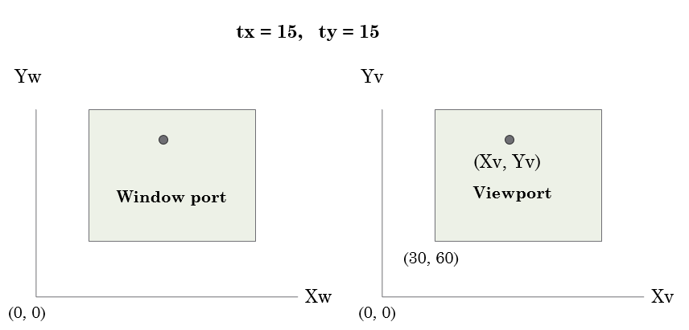
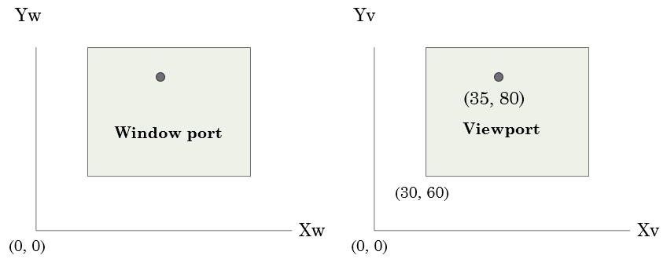
Example-05:
Find (Xv, Yv) = ?
Example-06:
Find (tx, tx) = ?

Slide 13
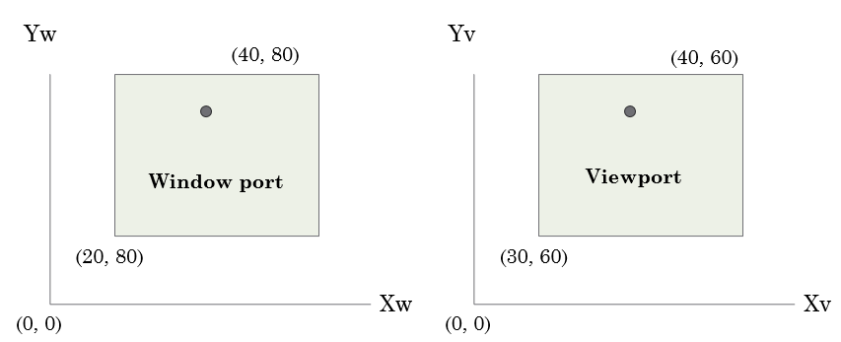
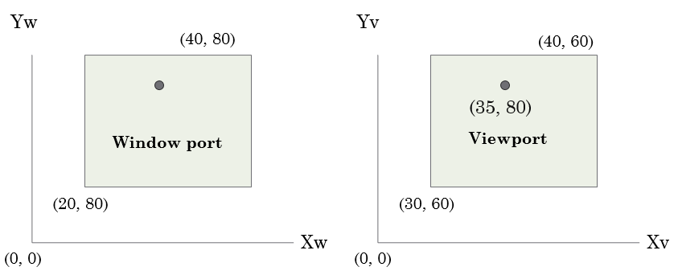
Example-07:
Find (Sx, Sy) = ?
Example-08:
Find (Xw, Yw) = ?
Find (Sx, Sy) = ?
Find (tx, ty) = ?

Slide 14
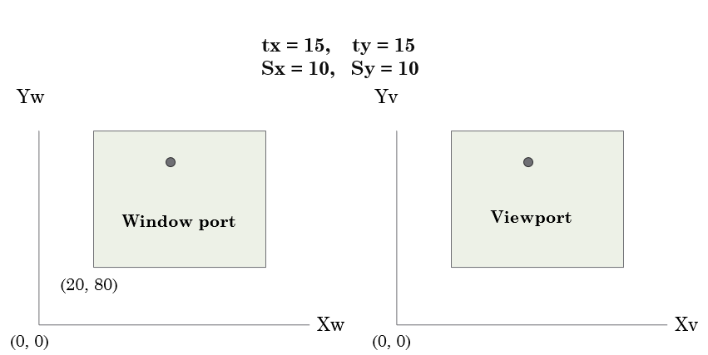
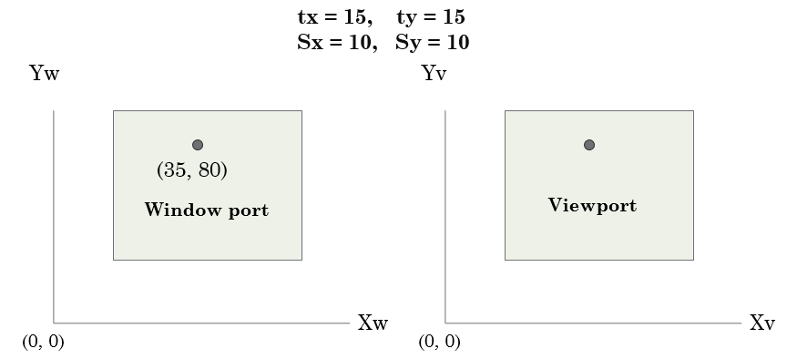
Example-09:
Find (Xw, Yw) = ?
Example-10:
Find (Xwmin, Ywmin) = ?

Slide 15
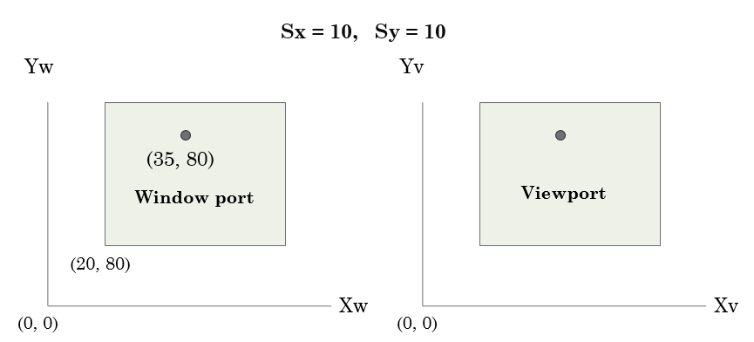
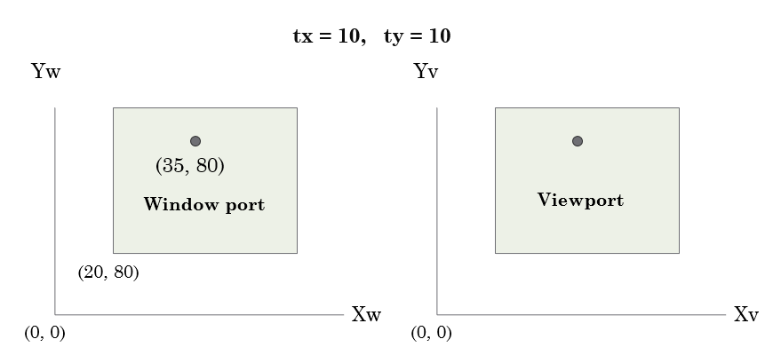
Example-11:
Find (tx, ty) = ?
Example-12:
Find (tx, ty) = ?

Slide 16
tx = 10, ty = 10
Yw
Yv
(40, 80)
(40, 60)
(35, 80)
(35, 80)
Window port
Viewport
(20, 80)
(30, 60)
Xw
Xv
(0, 0)
(0, 0)

Slide 18
Viewing transformation
We know that the picture is stored in the computer memory using any convenient cartesian coordinate system, referred to as world coordinate system (WCS). However, when picture is displayed on the display device it is measured in physical device coordinate system (PDCS) corresponding to the display device.
Therefore, displaying an image of a picture involves mapping the coordinates of the points and lines that form the picture into the appropriate physical device coordinate where the image is to be displayed.
This mapping of coordinates is achieved with the use of coordinate transformation known as viewing transformation.
The viewing transformation which maps picture coordinates in the WCS to display coordinates in PDCS is performed by the following transformations :
Normalization transformation (N) and
Workstation transformation (W)

Slide 19
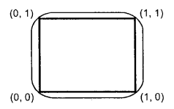
Normalization transformation
We know that, different display devices may have different screen sizes as measured in pixels. Size of the screen in pixels increases as resolution of the screen increases.
When picture is defined in the pixel values then it is displayed large in size on the low resolution screen while small in size on the high resolution screen.
To avoid this and to make our programs to be device independent, we have to define the picture coordinates in some units other than pixels and use the interpreter to convert these coordinates to appropriate pixel values for the particular display device. The device independent units are called the normalized device coordinates.
In these units, the screen measures 1 unit wide and 1 unit length as shown in the Fig. 5.3. The lower left corner of the screen is the origin, and the upper-right corner is the point (1, 1). The point(0.5, 0.5) is the center of the screen no matter what the physical dimensions or resolution of the actual display device may be.
Fig. 5.3: Entire normalized device screen coordinates.

Slide 20
The interpreter uses a simple linear formula to convert the normalized device coordinates to the actual device coordinates.
X = X_{n} x X_{w} ................................................................. (5.1)
Y = Y_{n} x Y_{H} …………………………………………….... (5.2)
where
X : Actual device x coordinate
Y : Actual device y coordinate
X_{n} : Normalized x coordinate
Y_{n} : Normalized y coordinate
X_{w} : Width of actual screen in pixels
Y_{H} : Height of actual screen in pixels
The transformation which maps the world coordinate to normalized device coordinate is called normalization transformation. It involves scaling of x and y, thus it is also referred to as scaling transformation.

Slide 21
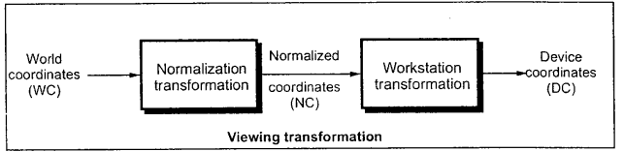
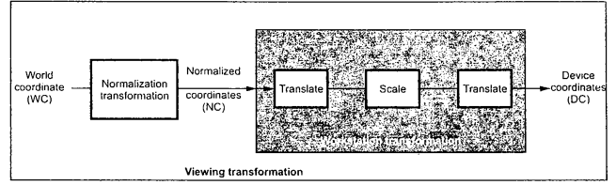
Workstation transformation
The transformation which maps the normalized device coordinates to physical device coordinates is called workstation transformation.
The viewing transformation is the combination of normalization transformation and workstation transformations as shown in the Fig. 5.4. It is given as
V = N.W …………………………………..... (5.3)

Slide 22
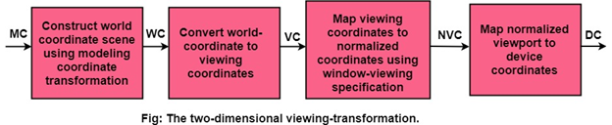
2D Viewing-Transformation Pipeline
First, we construct the scene in world coordinate using the output primitives and attributes.
To obtain a particular orientation, we can set up a 2-D viewing coordinate system in the window coordinate plane and define a window in viewing coordinates system.
Once the viewing frame is established, are then transform description in world coordinates to viewing coordinates.
Then, we define viewport in normalized coordinates (range from 0 to 1) and map the viewing coordinates description of the scene to normalized coordinates.
At the final step, all parts of the picture that (i.e., outside the viewport are dipped, and the contents are transferred to device coordinates).

Slide 23
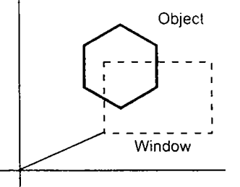
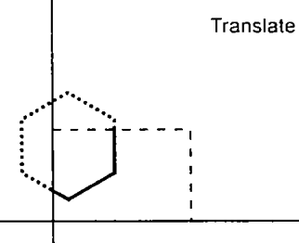
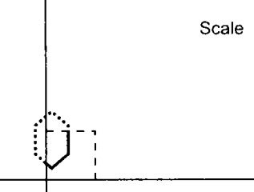
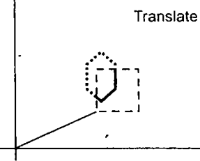
We know that world coordinate system (WCS) is infinite in extent and the device display area is finite. Therefore, to perform a viewing transformation we select a finite world coordinate area for display called a window. An area on a device to which a window is mapped is called a viewport. The window defines what is to be viewed; the viewport defines where it is to be displayed, as shown in the Fig. 5.5.
The window defined in world coordinates is first transformed into the normalized device coordinates. The normalized window is then transformed into the viewport coordinate. This window to viewport coordinate transformation is known as workstation transformation. It is achieved by performing following steps :
The object together with its window is translated until the lower left corner of the window is at the origin.
Object and window are scaled until the window has the dimensions of the viewport.
Translate the viewport to its correct position on the screen.
Therefore, the workstation transformation is given as:
W = T . S . T⁻¹
Fig:- Step in workstation transformation

Slide 24
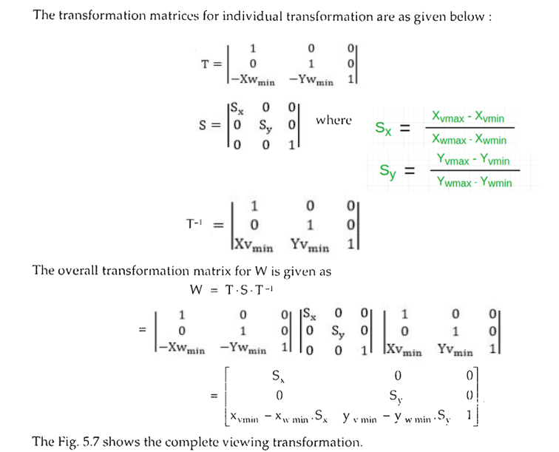

Slide 25
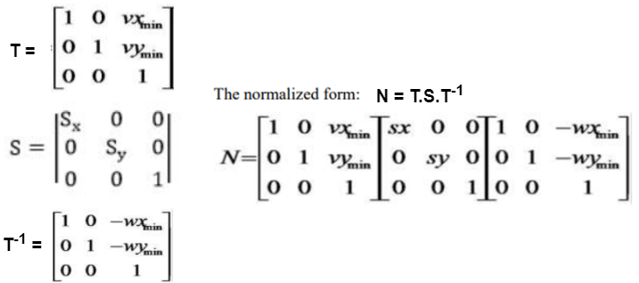
Another way:

Slide 26
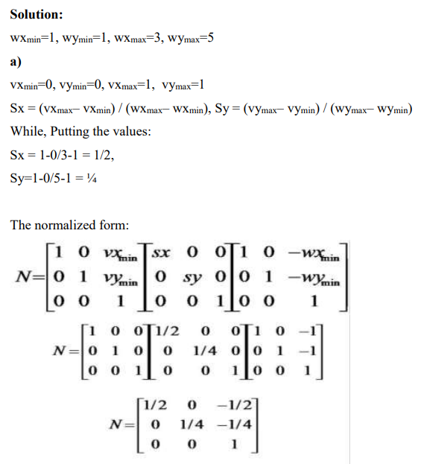
Example-02: Find normalization transformation that maps a window whose lower-left corner is at (1,1) and upper right corner is at (3,5) onto: a) Viewport with lower-left corner (0,0) and upper right corner (1,1) b) Viewport with lower left corner (0,0) and upper right corner (1/2,1/2).

Slide 27
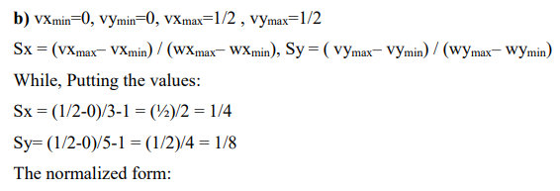
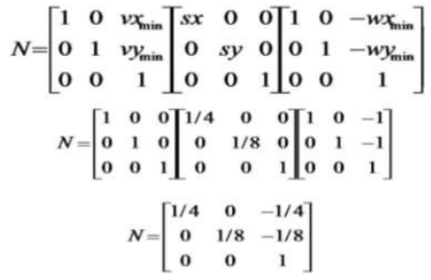

Slide 28
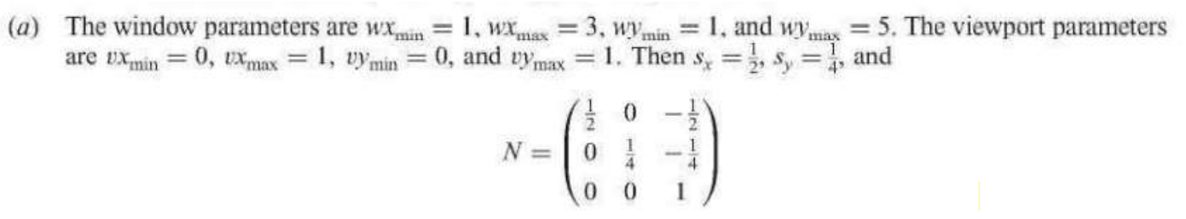
Example-03: Find normalization transformation that maps a window whose lower-left corner is at (1,1) and upper right corner is at (3,5) onto: a) Viewport that is the entire normalized device screen.
Solution:

Slide 29
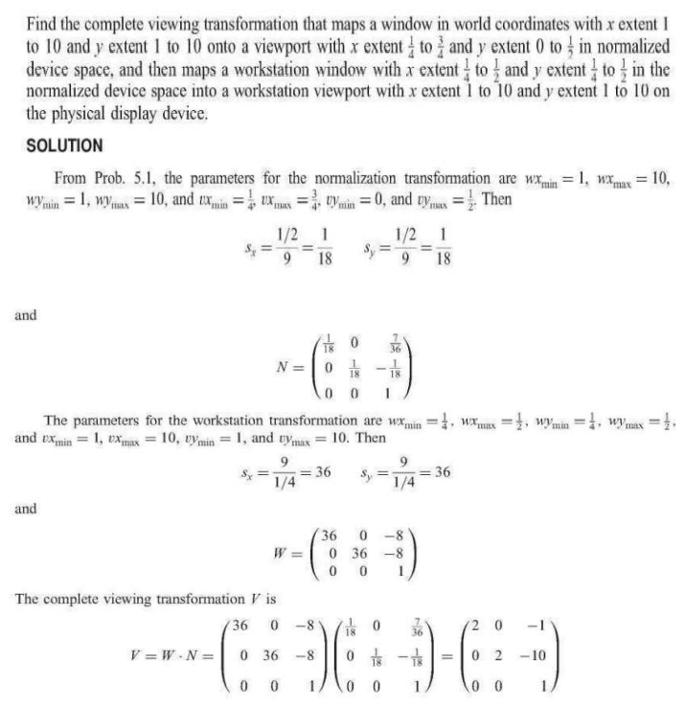
Example-04:

Slide 31
Difference Between Window Port And Viewport
Window port | Viewport
Window port is the coordinate area specially selected for the display. | An area on display device to which a window is mapped.
Region created according to the world coordinates | Region created according to device coordinates
It is a region selected from the real world. It is a graphically control thing and composed of visual areas along with some of its program controlled with help of window decoration. | It is the region in computer graphics which is a polygon viewing region.
A window port can be defined with the help of a GWINDOW statement. | A view port can be defined with the help of a GPORT command.
You can define the window to be larger than, the same as or smaller than the actual range of data values, depending on whether you want to show all of the data or only part of the data. | The rectangular portion of the interface window that defines where the image will defines where the image will actually appear.
Window defines what is to be viewed. | Viewport defines where the window to be displayed.

Slide 32
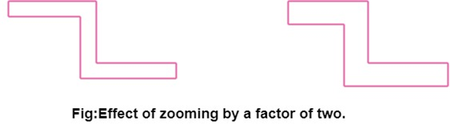
Computer Graphics Zooming
Zooming is a transformation often provided with an imaginary software. The transformation effectively scales down or blows up a pixel map or a portion of it with the instructions from the user. Such scaling is commonly implemented at the pixel level rather than at the coordinates level. A video display or an image is necessarily a pixel map, i.e., a collection of pixels which are the smallest addressable elements of a picture. The process of zooming replicates pixels along successive scan lines.
Example: for a zoom factor of two
Each pixel value is used four times twice on each of the two successive scan lines.
Figure shows the effect of zooming by a factor of 2.

Slide 33
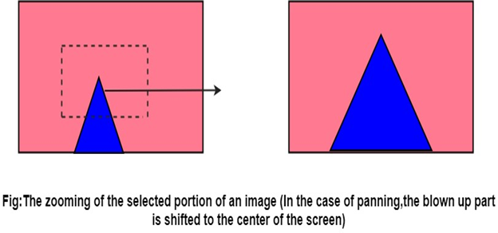
Such integration of pixels sometimes involves replication using a set of ordered patterns, commonly known as Dithering.
The two most common dither types are:
Ordered dither.
Random dither.
There are widely used, especially when the grey levels (share of brightness) are synthetically generated.

Slide 34
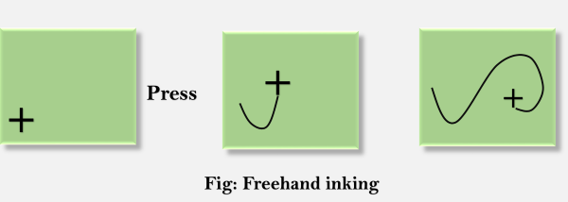
Computer Graphics Panning
The process of panning acts as a qualifier to the zooming transformation. This step moves the scaled up portion of the image to the center of the screen and depending on the scale factor, fill up the entire screen.
Advantage: Effective increase in zoom area in all four direction even if the selected image portion (for zooming) is close to the screen boundary.
Inking:
If we sample the position of a graphical input device at regular intervals and display a dot at each sampled position, a trial will be displayed of the movement of the device. This technique which closely simulates the effect of drawing on paper is called Inking.
For many years the primary use of inking has been in conjunction with online character-recognition programs.
Scissoring:
In computer graphics, the deleting of any parts of an image which falls outside of a window that has been sized and laid the original vision ever. It is also called the clipping.

